Slide 1


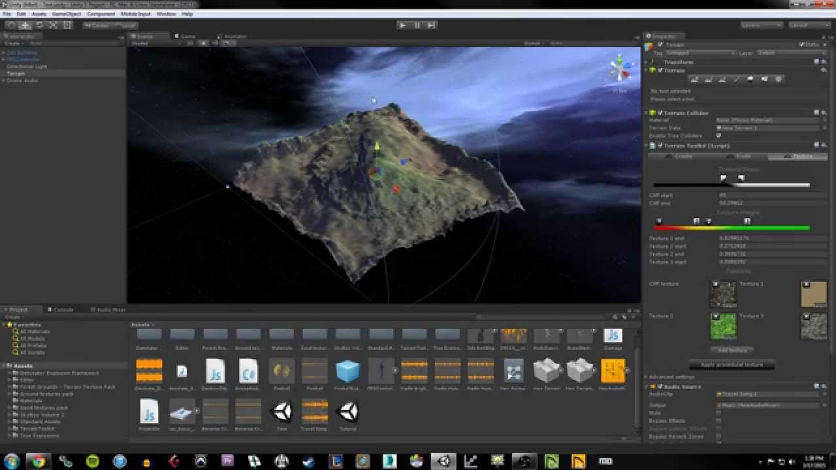
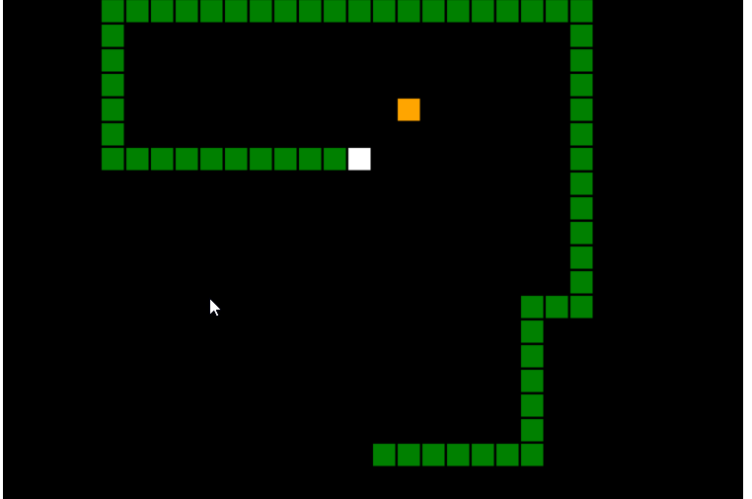
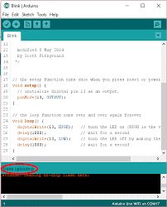

Programming Merit Badge

Slide 2


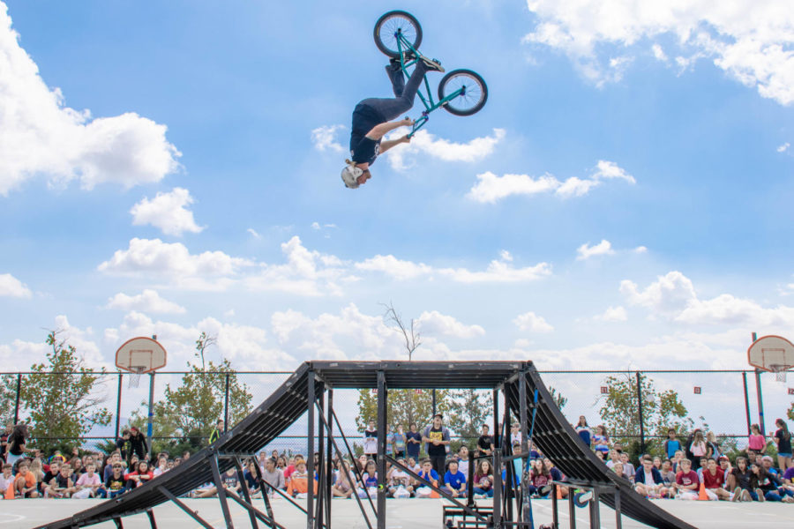
Goals
Expose you to programming concepts and introduce you to coding
Start you off safely
Get you going on your own
Not this!

Slide 3


About Me
Currently Director of Enterprise Architecture for the J.M. Smucker Co
Had my own consulting business for 17 years
Starting programming at age 11
Have programmed in over 60 languages and still learning new ones!

Slide 4
About Me
A few of the programming languages that I have used
ADF | BPEL | Fortran | Machine Code | Powerbuilder | T-SQL
ActionScript | C | FoxPro | MFC | Powershell | Unity
Active Server Pages | C# | Groovy | Objective C | Prime Basic | VBA
Advanced Revelation | C++ | HTML | Oracle Forms | Pro*C | VBScript
Assembly Language | Clipper | Inform | Oracle Reports | Prolog | Visual Basic
Awk | CSH | Java | Oracle Workflow | Python | Visual C
Bash | CURL | JavaScript | Pascal | Qbasic | XML
Basic | Dbase | JSP | Perl | REXX | XML Publisher
Batch | Delphi | KSH | PHP | Scratch | XPATH
BI Publisher | ESQL | LISP | PL/SQL | SED | XQUERY

Slide 5
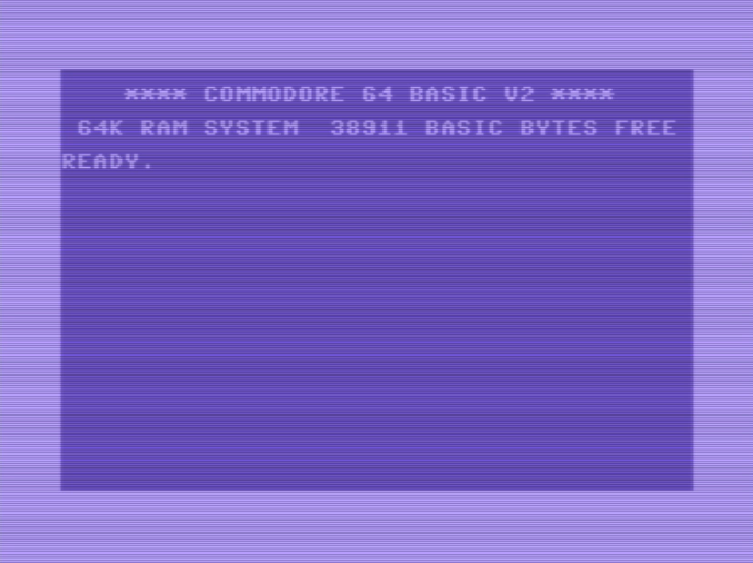

1st Program
Picture the scene
It was 1980, I was 11 and wanted to buy an Atari 5200 to play games
My oldest brother wanted to buy a computer instead???!
The salesperson came over and showed us a Commodore 64 which could play games and write code
He wrote the following and I was hooked. I could write my own games!

Slide 6
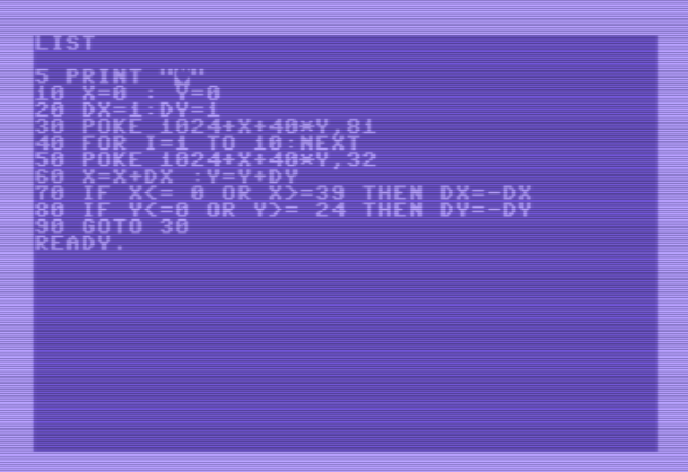

Let’s try it!
Vice 64 Emulator

Slide 7
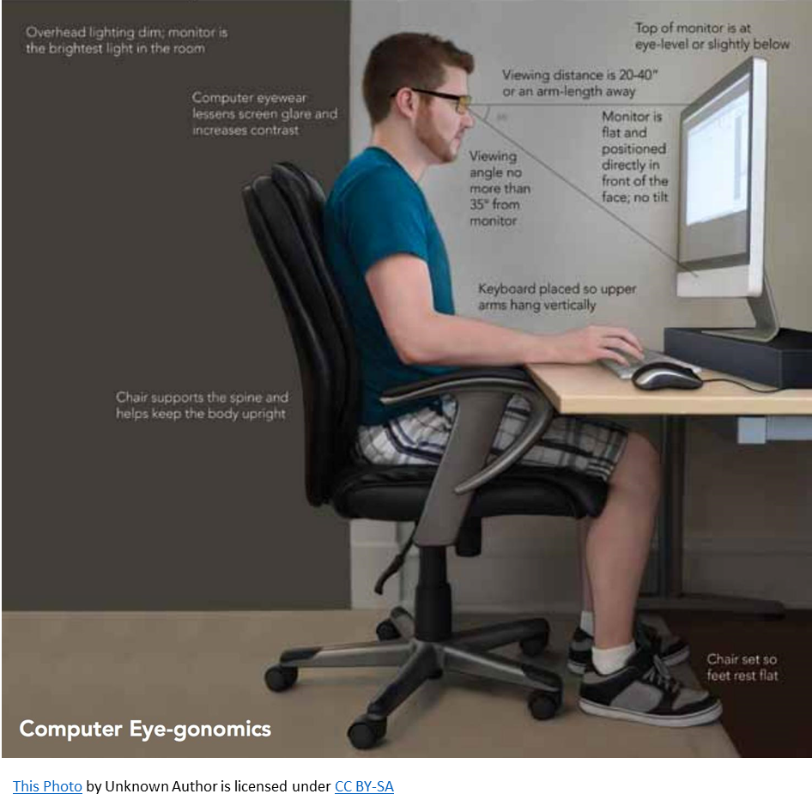

Requirement #1 - Safety
Physical
Online
Notes:
The benefit is not this deck. It’s the interaction we’ve had with the Program Team. We have learned a lot along this journey.
Thank you!

Slide 8
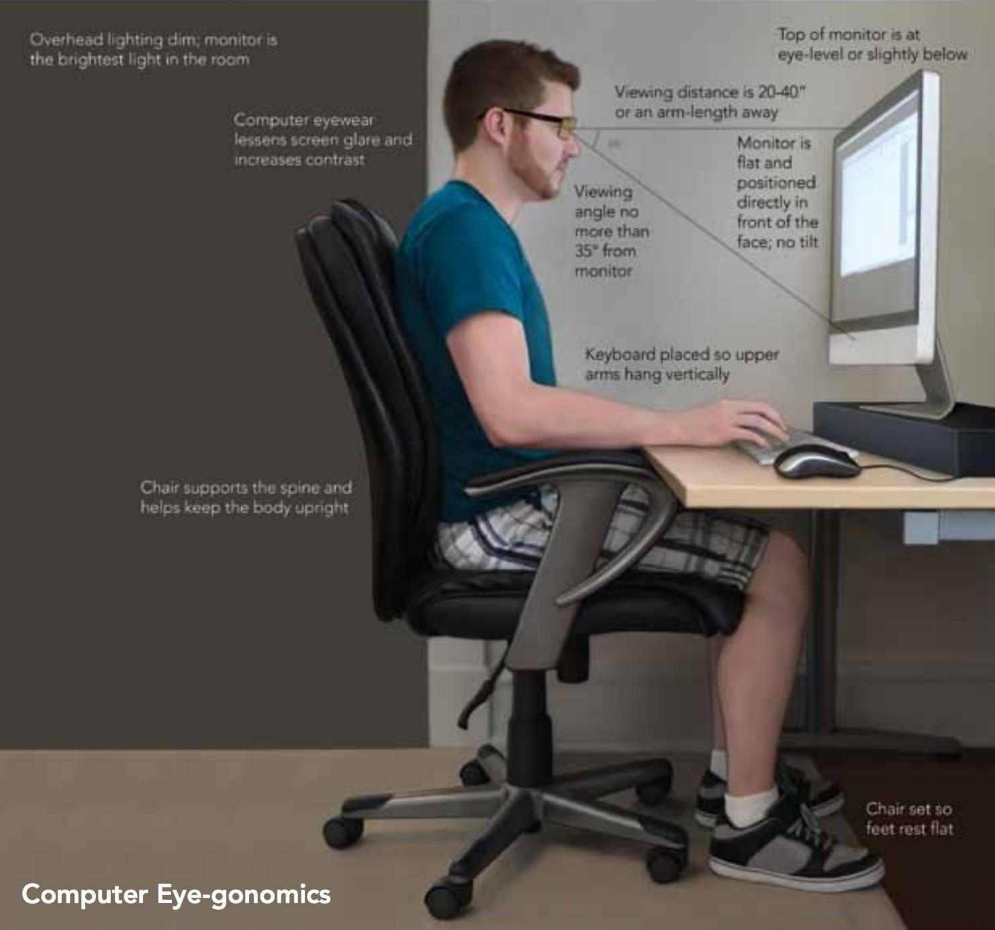
Physical Safety
Programming can be harmful if
You are not seated properly
Your monitor is not at the right viewing angle
Your elbows are not at 90 degrees
Head positioned correctly
Area is not well lit
Electrical cords neat and grounded

Slide 9
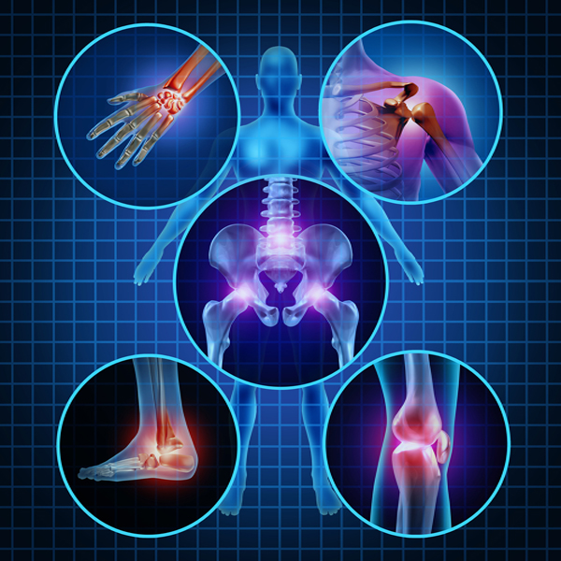
Physical Safety
Repetitive Stress Injuries
Caused by stress on your joints from muscles and tendons. Very painful!
Types
Carpel Tunnel - Wrist
Cervical Radiculopathy - Neck
Epicondylitis - Elbow
Reflex Sympathetic Dystrophy - Hands
Tendonitis = Elbows, Wrists
This Photo by Unknown Author is licensed under CC BY-SA
Notes:
The benefit is not this deck. It’s the interaction we’ve had with the Program Team. We have learned a lot along this journey.
Thank you!

Slide 10
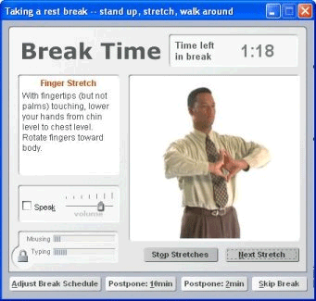
Physical Safety
Prevention
Sit Properly
Take Breaks
Standing Desks
Look Away to Prevent Eye Strain
Get up and move
Stretch neck and wrists
This Photo by Unknown Author is licensed under CC BY-SA
Notes:
The benefit is not this deck. It’s the interaction we’ve had with the Program Team. We have learned a lot along this journey.
Thank you!

Slide 11
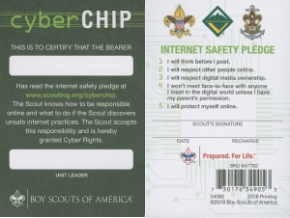

Cyber Safety
You have already!
Read and sign the Level II Internet Safety Pledge from NetSmartz
Written and signed a personalized contract with your parent or guardian that outlines rules for using the computer and mobile devices, including what you can download, what you can post, and consequences for inappropriate use.

Slide 12
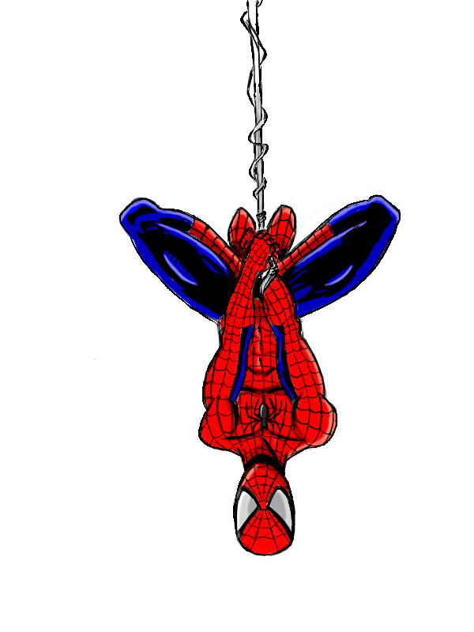
Cyber Safety
What Else?
With Great Power Comes Great Responsibility
Programmers can
Materially impact their computers by installing software to write code
Download source code that can compromise their machine
Install libraries or programs that may have adware, malware, viruses
Affect features at low level that can expose their computer to risks

Slide 13

Cyber Safety
Programming Online Risks
Programming may require you to
Visit and post on forums and communities
Sign up for accounts that require payment for services
Register emails with personal information
Research and encounter inappropriate content on YouTube etc

Slide 14
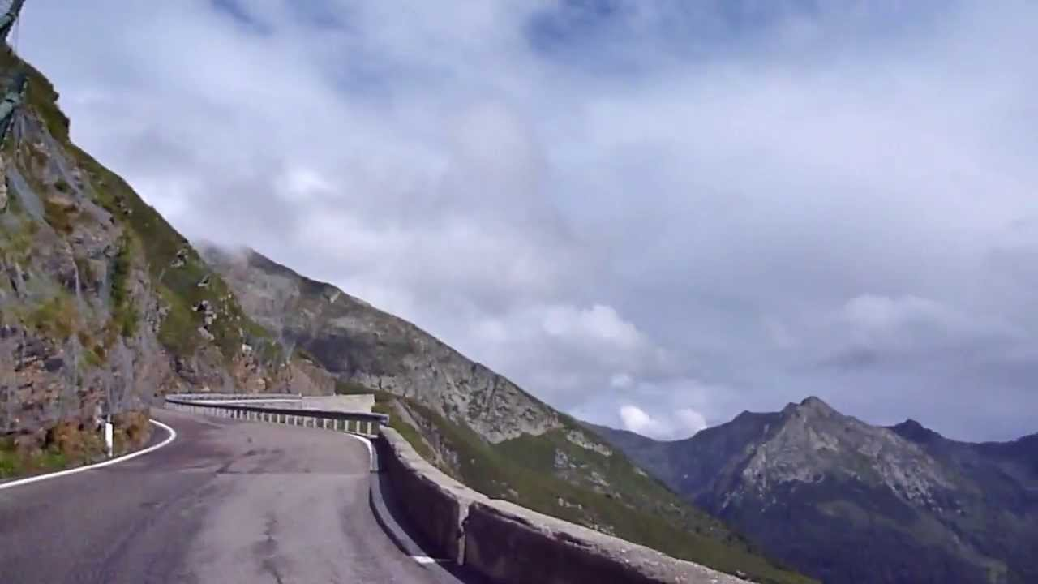
Cyber Safety
How we will stay safe
Rules for our Merit Badge Program
Only use a computer approved by your parent/guardian & counselor for this badge
All downloads of programs, code, and libraries should be approved by your parent/guardian & counselor
Only sites and sources approved by your counselor should be used for reference
You parent/guardian will need to approve and monitor online accounts

Slide 15
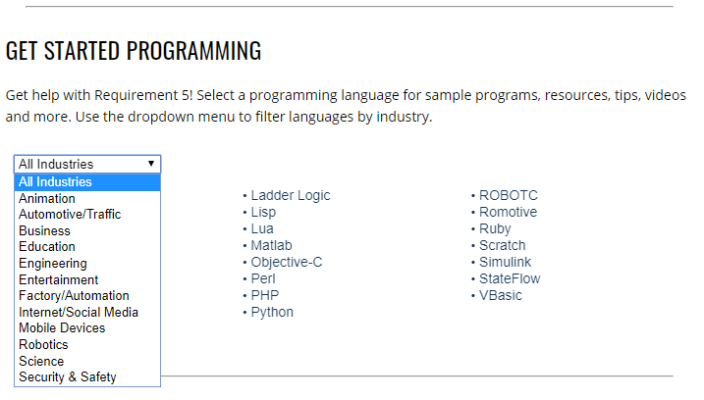

Industry & Languages
Where do we go next?
?
?
?
?
?
?
?
This Photo by Unknown Author is licensed under CC BY-SA

